Slide 1
Seminar of Oslo Commune and OXLO
How can NAV help you find a job?
A look at employment schemes in Norway
Litteraturhuset, Oslo
20 November 2019

Slide 2


CPN as a Platform....
Liiteraturhuset, 20/11 2019
Dr. Xiuhua Zhang

Slide 3

Visions of CPN
To provide a social networking platform and enhance communication among Chinese living in Norway and facilitate fellow members’ career advancement and academic achievement
To promote mutual understanding and friendship between people of Norway and China and to promote Chinese tradition and culture in Norway.
To enhance communications and cooperation between Norway and China in areas such as: culture and education, business and economy, science and technology, social development, etc.
To provide consulting services for relevant organizations and enterprises in China and Norway.
To promote cultural diversity and encourage active integration of the immigrants into the Norwegian society based on the abiding Norwegian laws and regulations.

Slide 4

Who are we?
A Professional Association established in Oct. 2013 (CPN for short, cpn2003.no)
Runing Competence Center for Immigrants since 2013 supported by IMDI
‘Top 10 Immigrants’award: Five members of CPN awarded in 2005，2008，2009, 2011 and 2012
CPN membership – Higher education and Chinese roots, living or working in Norway
Over 800/1000 members: One academician, 1/3 PhD/Dr.degree，1/2 master degree and rest bachelor; including student membership; having CPN Junior Club
Major and scienctific background: nature science, medicine, engineering, art, design, social science etc. IT and economy/finance dominated
Representing all kinds of organizations: public and private sectors, university, research insititution....

Slide 5
Development of CPN
Innovation & China
Chinese delegation
2013-
Media/Intergration
2010-12
Member’s interest
2007-09
2003-06
Workshop/seminar on Innovation
Government dialogue
More
Meeting Chinese delegations
Competence center for immigrants
Working in Norway
NRK
Aftenposten
Nor-Alumni
OL Beijing 2008
Shanghai Expo 2008
Multiculture festival/ERAS
Chinese new year celebration
Fashion, Choir
Photo competition

Slide 6




What we do?
1
Developing social network/ERAS/IMDi/EMI
2
Sharing information
Entrepreuship and startups
3
Working in Norway and business culture
Competence Center for Immigrants/CCI
4
Promoting and connecting collaboration between China and Norway

Slide 7

How we do?
In Norway
In China
Organizing seminars from members professional works to all groups
Connnecting Norwegian companies to China
Meeting delegations from China and making a match
Partners to different networks, Open Innovation Lab
Making contacts via members natural connections between two countries
Reference groups on demand
Atending Conferences by invitation from China
Making cooperation agreements with relevant partners
CPN Contact points in China
100/1000 people plan at province or national levels
Following norwergian state-visit to China
Doing joined projects at work
Take norwegian delegations to China, a next step?

Slide 8
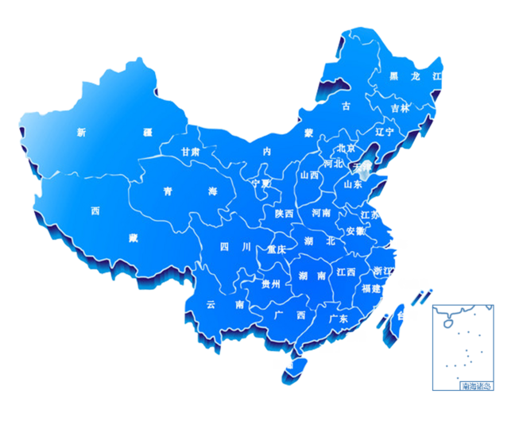
Contact Point in China

Slide 9
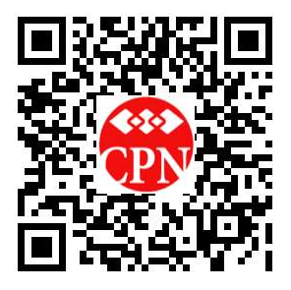
Welcome to join CPN & CPN activities
CPN website
QR code
https://cpn2003.no/en/user/register

Slide 10
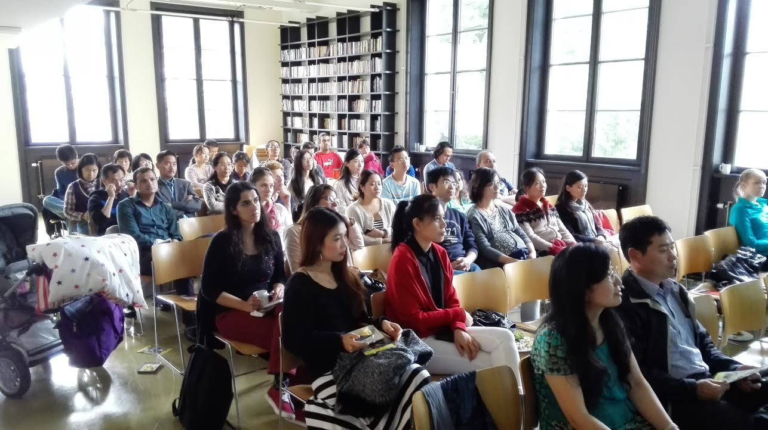
CPN activities 2019

Slide 11
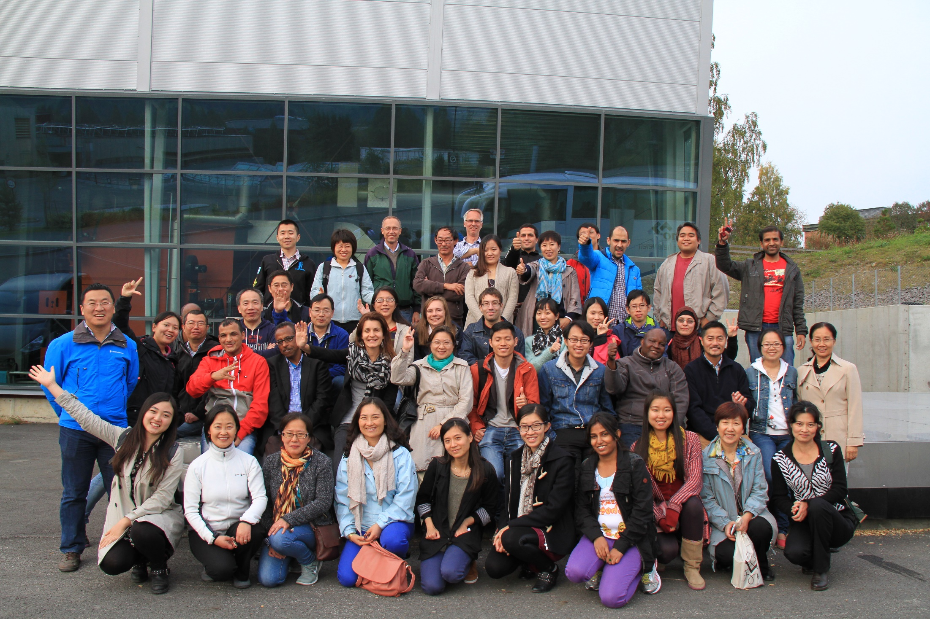
CPN activities 2019

